Slide 1


Viz Notes:
Splash Screen
Frame 1
Slide 1 of 3
Layout: 50:50 Slide
Treatment: Show the given image on the right or on full screen and add text in sync with audio AX1.
Image source:
https://as2.ftcdn.net/jpg/02/67/79/19/500_F_267791967_1bpemdJqil6sEv2nQFHbvw9pQUQWEeg6.jpg
Surveillance is a fundamental part of public health practice.
Notes:
<AX1> Did you know that ssurveillance is a fundamental part of public health practices…

Slide 2

Viz Notes:
Splash Screen
Frame 1
Slide 2 of 3
Layout: 50:50 Slide
Treatment: Show the given image on the right or on full screen and add text in sync with audio AX2.
Image source:
https://as2.ftcdn.net/jpg/03/30/47/11/500_F_330471142_agVBmfpB5DBQAwZT7jTQAxqZRtyuRrSr.jpg
Surveillance is critical during times of crises such as epidemics, natural disasters, famines, and conflicts.
Notes:
<AX2> …and it becomes critical during the times of crises such as epidemics, natural disasters, famines, and conflicts?

Slide 3

Viz Notes:
Splash Screen
Frame 1
Slide 3 of 3
Layout: 50:50 Slide
Treatment: Show the given image on the right or on full screen and add text in sync with audio AX1.
Image source:
https://t4.ftcdn.net/jpg/02/82/42/09/240_F_282420918_mmJzZjI5QNO3eWyCrS2eLpvbkh7hj4TM.jpg
Surveillance during major emergencies focuses on diseases or conditions with epidemic potential or with the highest risk of mortality.
Notes:
<AX3> The surveillance during major emergencies focuses on diseases or conditions with epidemic potential or with the highest risk of mortality.
<AX4> Today we are going to learn about this, and more!

Slide 4
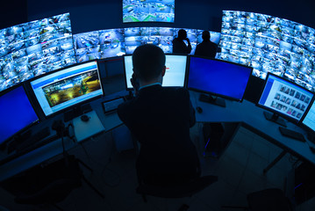
Session Title
Viz. notes:
Frame: 2
This is a Welcome screen.
This is slide 1 of 1
Layout Name: 1.1 Welcome Layout
External Image:
https://t3.ftcdn.net/jpg/01/96/63/64/240_F_196636468_bihE0du2Nn44sgO39b8aqkZmug15bNH2.jpg
Treatment:
The background image appears on screen load.
The module name appears in sync with AX1
This slide should automatically transition to the next.
Setting Up and Strengthening Disease Surveillance Systems During Emergencies Session
Notes:
<AX1> Welcome to the session, “Setting Up and Strengthening Disease Surveillance Systems During Emergencies.”

Slide 5




Learning Objectives
Viz. notes:
Frame: 3
Learning Objectives
Slide 1 of 1
Layout Name: Learning Objectives
External Icons:
https://static.thenounproject.com/png/2479513-200.png
https://static.thenounproject.com/png/1874145-200.png
https://static.thenounproject.com/png/2063296-200.png
Treatment:
Follow the same strategy as in other courses.
On completion of audio, the Next button activates, and the learner can proceed to the Next frame.
Splash Game
Learning Objectives
When you have completed this session, you will be able to:
Define specific characteristics of the disease surveillance system during emergencies.
List the various challenges during surveillance.
Explain the structuring of new and strengthening existing surveillance system to function during emergencies.
Notes:
<AX1> When you have completed this session, you will be able to:
Define specific characteristics of the disease surveillance system during emergencies;
List the various challenges during surveillance; and
Explain the structuring of new and strengthening existing surveillance system to function during emergencies.

Slide 6
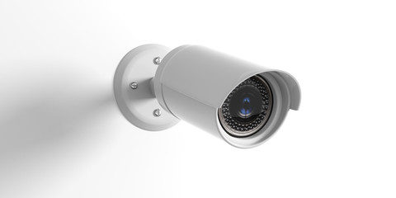
Check Your Understanding
Resources
Viz. notes:
Frame : 4
Slide 1 of 1
Layout Name:
External image:
https://t3.ftcdn.net/jpg/02/43/28/28/240_F_243282844_YKLrcB3vfWatRwEmsIuHII1xf4whqTuF.jpg
Treatment:
Sync the image of the camera with AX1.
The display the OST along with Ax2.
Appear the text plan, Implement and Evaluate in sync with Ax2
Setting Up and Strengthening Disease Surveillance Systems During Emergencies I Introduction
Teambuilding I Check Your Understanding
The ongoing systematic collection, analysis, and interpretation of data along with the dissemination of information in order to plan, implement, and evaluate public health interventions is known as Surveillance.
Plan
Implement
Evaluate
Notes:
[AX1] When you hear the word surveillance, the first thing that comes to mind is keeping an eye.
[Ax2] Surveillance during an emergency can be termed as the ongoing systematic collection, analysis, and interpretation of data followed by dissemination of the information which is used to plan, implement, and evaluate public health interventions.

Slide 7





Check Your Understanding
Resources
Viz. notes:
Frame : 5
Slide 1 of 1
Layout Name:
External image: With first line of AX1, fade in the images. With the remaining AX2-AX6, fade in the OST.
https://t3.ftcdn.net/jpg/01/85/11/24/240_F_185112497_aohnXnpywNISkZDH389sXLl25yeCreTI.jpg
https://t3.ftcdn.net/jpg/02/36/47/48/240_F_236474811_qxdRjYgHTZZgBnjzG7gmmiMGNwe6Jp70.jpg
https://stock.adobe.com/images/doctor-hand-with-stethoscope-and-ui-icon-medical-in-hospital-with-medical-technology-network-concept/271127258
https://t4.ftcdn.net/jpg/02/24/21/31/240_F_224213160_X31YrMYiAQwHMYomYJUvlPBCYq6j8zqV.jpg
https://t4.ftcdn.net/jpg/03/36/92/33/240_F_336923358_c1ays6wyj2r14T7nPJG2nMROKmeG5v6Y.jpg
Treatment:
Display the first image on the cleft with Ax1;
Then sync the other images and OST of the smart art with corresponding Ax2-Ax6.
Setting Up and Strengthening Disease Surveillance Systems During Emergencies I What is Surveillance?
Teambuilding I Check Your Understanding
Network of health services delivery actors
Detect changes in defined health events or indicators with the help of training
Analyze health event data periodically and generate a response when an event threshold is crossed
Monitor responses and interventions about the program and resource use
Release iterative trends and events over time
Notes:
[AX1] After learning about the definition, let us know about surveillance in detail.
[Ax2] Surveillance is a network of health services delivery actors.
[Ax3] These health services delivery actors are trained to detect changes in defined health events or indicators.
[Ax4] They analyze health event data periodically and generate a response whenever an event threshold is crossed.
[Ax5] They monitor responses and interventions along with the information about the program and resource use.
[Ax6] They also release iterative trends and events over time.

Slide 8



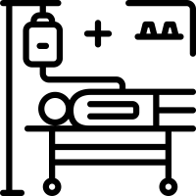

Check Your Understanding
Resources
Viz. notes:
Frame : 6
Slide 1 of 2
External image:
https://static.thenounproject.com/png/2068974-200.png
https://static.thenounproject.com/png/521120-200.png
https://static.thenounproject.com/png/2248934-200.png
https://static.thenounproject.com/png/1873150-200.png
Treatment:
Display the image with four icons with Ax1.
Display the instruction with the IAX.
Setting Up and Strengthening Disease Surveillance Systems During Emergencies I What are the Limitations?
Teambuilding I Check Your Understanding
Surveillance Limitations
Surveillance Limitations
Click each icon to know more.
Notes:
[AX1] Like everything has limitations, surveillance has limitations too.
[IAX] Click each icon to know more.

Slide 9
Check Your Understanding
Resources
Viz. notes:
Frame : 6
Slide 2 of 2
Layout Name:
Treatment:
When the user clicks each icon then show the corresponding OST. No need to lock the order of icons.
Setting Up and Strengthening Disease Surveillance Systems During Emergencies I What are the Limitations?
Teambuilding I Check Your Understanding
Surveillance cannot explain the reasons for improvement and replacing M&E.
Surveillance cannot capture every morbidity event.
Surveillance Limitations
Surveillance Limitations
Surveillance cannot explain the root causes of an event.
Surveillance cannot provide true incidence or prevalence of event in community.
Click each tab to know more.

Slide 10
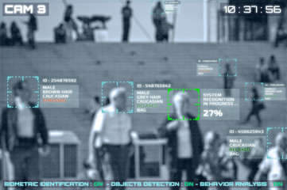
Check Your Understanding
Resources
Viz. notes:
Frame : 7
Slide 1 of 13
Layout Name:
External image:
https://t3.ftcdn.net/jpg/02/07/01/64/240_F_207016489_eV9vy1bmJtMaWFaSxkfWBeJpTNwhOcrt.jpg
Treatment:
Display image with Ax1. Display the tabs with last sentence of AX1.
Show the instruction with IAX.
Setting Up and Strengthening Disease Surveillance Systems During Emergencies I What are the Many Faces of Surveillance?
Job 1
Job 2
Job 3
Job 4
Job 5
Job 6
Job 7
Job 8
Job 9
Job 10
Job 11
Job 12
Click each tab to know more.
Notes:
[Ax1] Let us now discuss about the many faces of surveillance. It just does not have one area to look after. Here are some of the jobs that are taken care under surveillance.
[IAX] Click each tab to learn more.

Slide 11
Check Your Understanding
Resources
Viz. notes:
Frame : 7
Slide 2-13 of 13
Layout Name:
External image:
https://t3.ftcdn.net/jpg/02/07/01/64/240_F_207016489_eV9vy1bmJtMaWFaSxkfWBeJpTNwhOcrt.jpg
Treatment:
Fade the previous image in the background and show the text corresponding to each tab one by one as the user clicks, The current tab should always be highlighted. Close the previous tab when the user clicks a new tab. This screen will only have OST and no audio.
Setting Up and Strengthening Disease Surveillance Systems During Emergencies I What are the Many Faces of Surveillance?
Job 1
Is the crude mortality rate changing?
Job 2
Are the cause-specific or age-specific rates changing?
Job 3
Are we seeing an increase in cholera cases?
Job 4
Are we seeing a rise in traffic accidents?
Job 5
Is the health system functioning?
Job 6
Do we have the number of providers needed for the population?
Job 7
Have we achieved adequate immunization coverage?
Job 8
Are the rates of moderate to severe global acute malnutrition improving with targeted food distribution?
Job 9
Are we seeing more low birth weight infants?
Job 10
Are the WASH NGOs providing 15 l/p/day?
Job 11
What are the fecal coliform readings at the tap sites?
Job 12
How adequate is healthcare access for reproductive aged women?
Click each tab to know more.

Slide 12


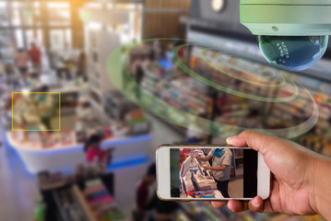
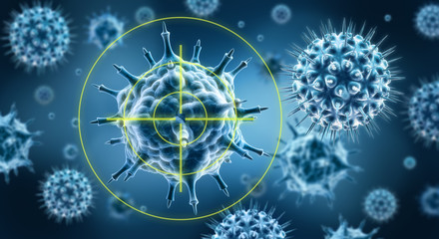
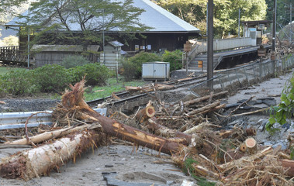

Check Your Understanding
Resources
Viz. notes:
Frame : 8
Slide 1 of 1
Layout Name:
External image:
https://t4.ftcdn.net/jpg/02/49/55/43/240_F_249554330_SurvpxEdhbgkiyBvfZLD43SoIl2sSmpk.jpg
https://t4.ftcdn.net/jpg/01/34/20/51/240_F_134205105_dEzunWxBriAleBfpO5J227D2hUFXkpOD.jpg
https://t3.ftcdn.net/jpg/02/71/54/38/240_F_271543896_pktKXaQ6TjHljsgAKTsxjCVA0qs5tn5Y.jpg
https://t4.ftcdn.net/jpg/01/97/75/95/240_F_197759518_9GvIa2TsH6Mf4BljCsqREctx1xAeK1xK.jpg
https://t4.ftcdn.net/jpg/02/97/75/65/240_F_297756514_57siTwQqEwqWuOYGtXXNG8Y8D5RYDRW8.jpg
https://as1.ftcdn.net/jpg/01/78/83/74/500_F_178837442_e9LEqcEoE2PddDgQ6Qq7BP0cdzQipq1K.jpg
Treatment:
Display the OST with Ax1. Then show the images along with the OST
Start the first image with the first smart art and the bullet point.
Similarly follow for others.
Teambuilding I Check Your Understanding
Setting Up and Strengthening Disease Surveillance Systems During Emergencies I Communicable Diseases Surveillance During Emergencies
An effective surveillance should:
Establish other public health activities at the same time in the phase of emergency response.
Engage with a wide range of stakeholders.
Be simple and clear for workers as well as utilizers.
Define thresholds for the target diseases.
Function in the recovery phase of a disaster.
Integrate surveillance in the routine health information system.
Notes:
[Ax1] When we talk about effective surveillance, it should:
Establish other public health activities at the same time in the phase of emergency response;
Engage with a wide range of stakeholders;
Be simple and clear for workers as well as utilizers;
Define thresholds for the target diseases;
Function in the recovery phase of a disaster; and
Integrate surveillance in the routine health information system.

Slide 13

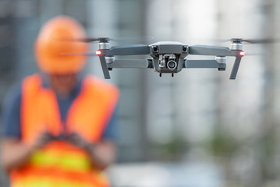




Check Your Understanding
Resources
Viz. notes:
Frame : 9
Slide 1 of 1
Layout Name:
External image:
https://static.thenounproject.com/png/1429617-200.png
https://static.thenounproject.com/png/2485457-200.png
https://static.thenounproject.com/png/105366-200.png
https://static.thenounproject.com/png/3117294-200.png
https://static.thenounproject.com/png/3165598-200.png
https://t3.ftcdn.net/jpg/02/12/91/68/240_F_212916800_z9BJwNTxcM2JsejZyiVn7Ib7fjIenfqd.jpg
Treatment:
Display the image with AX1.
Then Display the OST with the Ax2 first sentence. The show each icon along with the OST synced with the audio bullet points.
Teambuilding I Check Your Understanding
Setting Up and Strengthening Disease Surveillance Systems During Emergencies I Constructing Surveillance
CD surveillance should be designed to answer:
What do you want to know?
How often do you want to know?
Whom do you want to know about?
Where it should be done?
How should it be done?
Notes:
[Ax1] The surveillance designed during emergencies is known as Cluster Designation surveillance. It is also known as CD surveillance.
[Ax2] The CD surveillance should be designed during emergencies to answer the following questions:
What do you want to know?
How often do you want to know?
Whom do you want to know about?
Where it should be done?
How should it be done?

Slide 14





Check Your Understanding
Resources
Viz. notes:
Frame : 10
Slide 1 of 1
Layout Name:
External image:
https://t3.ftcdn.net/jpg/02/72/34/36/240_F_272343634_LER1KlI6P6DZGSxNxkagMOjQcC5gLc2W.jpg
https://t4.ftcdn.net/jpg/02/18/34/21/240_F_218342114_ikPOLdtEJ2mvKqAWqUZY8pQjVPlGHc3q.jpg
https://t3.ftcdn.net/jpg/02/71/60/08/240_F_271600813_ShFZe4tAREpS91eSrF10gE3IydQ69OiR.jpg
https://t4.ftcdn.net/jpg/01/01/31/71/240_F_101317181_iismSxKIKfcDd8OQaGpkbANOJNoi7SLf.jpg
https://t4.ftcdn.net/jpg/02/92/89/53/240_F_292895361_NZ044eeBMKCIEfGs9m2QKpcyHdjjgxNu.jpg
Treatment:
Sync the Ax1 with the OST.
Then display each audio starting from Ax2 insync with the image and the Smart art text.
Teambuilding I Check Your Understanding
Setting Up and Strengthening Disease Surveillance Systems During Emergencies I Challenges Faced While Surveillance
Challenges faced while surveillance:
Surveillance needs the buy-in of all stakeholders at all levels to ensure functionality and sustainability.
Surveillance is challenged by delays in getting the information and in reporting during times of emergency.
Surveillance can fail to analyze the collected data due to the availability of poor data.
Surveillance can fail to act because of limited resources and poor coordination.
Surveillance can fail to communicate the findings to all levels.
Notes:
[Ax1] Let us know the different challenges faced while surveillance.
[Ax2] Surveillance needs the buy-in of all stakeholders at all levels to ensure functionality and sustainability.
[Ax3] Surveillance is challenged by delays in getting the information, and in reporting during times of emergency.
[Ax4] Surveillance can fail to analyze the collected data due to the availability of poor data.
[Ax5] Surveillance can fail to act because of limited resources and poor coordination.
[Ax6] Surveillance can fail to communicate the findings to all levels.

Slide 15

Check Your Understanding
Resources
Viz. notes:
Frame : 11
Slide 1 of 1
Layout Name:
External image:
https://stock.adobe.com/images/monitoring-of-patient-in-operating-room-in-hospital/96773345 Treatment:
Display the image and OST with the Ax1.
Teambuilding I Check Your Understanding
Setting Up and Strengthening Disease Surveillance Systems During Emergencies I What Does Surveillance Require?
What does surveillance require?
Notes:
[Ax1] Now moving ahead, let us know what does surveillance require?

Slide 16

Check Your Understanding
Resources
Viz. notes:
Frame : 12
Slide 1 of 7
Layout Name:
External image:
Use the same image from the previous screen.
Treatment:
Show the image and OST and tabs with AX1.
Display the text in each tab along with the Corresponding audio.
Sync the instruction text with IAX.
Teambuilding I Check Your Understanding
Setting Up and Strengthening Disease Surveillance Systems During Emergencies I Surveillance Requirements: Time
Surveillance requires a proper time management.
1
2
3
4
5
6
Click each tab to know more.
Notes:
[Ax1] Surveillance requires a proper time management. Here are a few pointers that you should keep in mind while taking up time management.
[IAX] Click each tab to know more.

Slide 17
Check Your Understanding
Resources
Viz. notes:
Frame : 12
Slide 2-7 of 7
Teambuilding I Check Your Understanding
Setting Up and Strengthening Disease Surveillance Systems During Emergencies I Surveillance Requirements: Time
Surveillance requires a proper time management.
1
2
3
4
5
6
The relief operation begins usually in a few days to weeks.
The constructing surveillance is based on the type of crisis.
The use of factors like accessibility and security can limit the immediate construction of the surveillance.
The constructing surveillance should be readjusted frequently as the assessments reveal new needs and facts.
The constructing surveillance anticipates and predicts the health problems that are likely to emerge.
The frequency of reporting can change based on the type of the emergency.
Click each tab to know more.

Slide 18

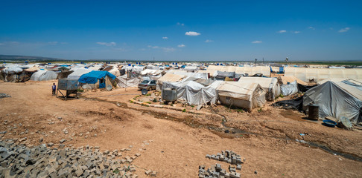
Check Your Understanding
Resources
Viz. notes:
Frame : 13
Slide 1 of 1
Layout Name:
External image:
https://t4.ftcdn.net/jpg/01/77/55/85/240_F_177558542_Iu3zpc5OB3DyIM17ZRHzazOJOeCQjPbr.jpg
https://t3.ftcdn.net/jpg/02/70/23/60/240_F_270236083_jJVrk67QyUAlGycdBi138xfpcN2nyzJX.jpg
Treatment:
Display the text header with the AX2.
Then sync the audio Ax2 ands Ax3 with the labels and the images.
Teambuilding I Check Your Understanding
Setting Up and Strengthening Disease Surveillance Systems During Emergencies I Surveillance Requirements: Place
Surveillance requires a proper place.
Know where displaced people are settled
Know about all the refugee and IDPs camps
Notes:
[Ax1] Surveillance requires a proper place.
[Ax2] It is important to know where displaced people are settled.
[Ax3] It is important to know about all the refugee, and internally displaced persons or IDPs camps. Always check whether these are prolonged or temporary.

Slide 19
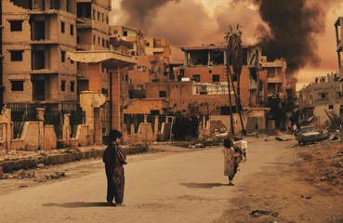

Check Your Understanding
Resources
Viz. notes:
Frame : 14
Slide 1 of 1
Layout Name:
External image:
https://t3.ftcdn.net/jpg/02/73/58/86/240_F_273588622_RyFJPwFH16s9GVBwKfhdKhQpx4MZ1J4J.jpg
https://t4.ftcdn.net/jpg/01/82/31/63/240_F_182316336_x3c7Y1QNpuqo3j6ygB8sgiHYWGt8EqP2.jpg
Treatment:
Display the OST at top with Ax1.
Then display the images along with Ax2 and Ax3.
Teambuilding I Check Your Understanding
Setting Up and Strengthening Disease Surveillance Systems During Emergencies I Surveillance Requirements: People
Surveillance should know about the people:
Knowledge about the refugee and IDPs
Idea about the population structure
Notes:
[Ax1] Surveillance should know the people living in the area.
[Ax2] Surveillance should know the refugee and IDPs. Some of these have been prolonged, and some are temporary.
[Ax3] Surveillance should have an idea about the population structure such as age groups, and other demographic data.

Slide 20
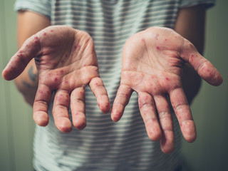



Check Your Understanding
Resources
Viz. notes:
Frame : 15
Slide 1 of 1
Layout Name:
External image:
https://t3.ftcdn.net/jpg/01/76/86/26/240_F_176862638_rPtYhNme3o87Xz9bhDhdEht9uCG1zi3h.jpg
https://t3.ftcdn.net/jpg/02/90/98/60/240_F_290986049_0atkLLVd9yn80d8deCljZJ4JfoBOh6gX.jpg
https://t4.ftcdn.net/jpg/03/32/66/01/240_F_332660164_Xa3yoJoPIvoTgRLnZ3yOsgXD2ABBd3X1.jpg
https://t3.ftcdn.net/jpg/02/15/51/02/240_F_215510203_X190ZCaWN1lD0U7ayTEQdAQOISWQqHbD.jpg
Treatment:
Display the OST on the top with Ax1.
Then show the images along with the Text in sync with the corresponding audio. The first image and text with Ax2. The images and text are placed in a clockwise manner.
Teambuilding I Check Your Understanding
Setting Up and Strengthening Disease Surveillance Systems During Emergencies I What Does Surveillance Measure?
Morbidity due to communicable diseases
Noncommunicable diseases
Mortality due to communicable and health services delivery
Resources available for curative and preventive care services
Notes:
[Ax1] However, the bigger question is what does surveillance measure?
[Ax2] Surveillance measures morbidity caused by communicable diseases such as measles, acute respiratory infections, meningitis, and diarrheal diseases.
[Ax3] Surveillance measures morbidity caused by noncommunicable diseases such as trauma, nutrition, chronic, and mental health.
[Ax4] Surveillance measures mortality due to communicable and health services delivery. This includes the crude mortality rates, mortality rate under 5 years, cause of death, etc.
[Ax5] Surveillance measures the resources available for curative and preventive care services.

Slide 21
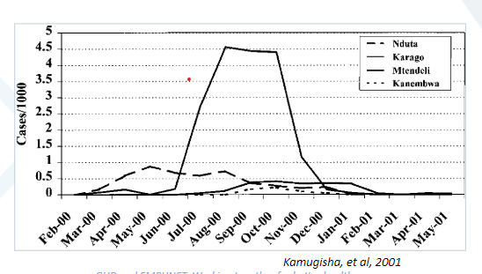
Check Your Understanding
Resources
Viz. notes:
Frame : 16
Slide 1 of 1
Layout Name:
External image:
Treatment: Please recreate the image from the source ppt.
Display the chart in sync with AX1 and Ax2.
Teambuilding I Check Your Understanding
Setting Up and Strengthening Disease Surveillance Systems During Emergencies I Monthly Report
Monthly Measles Incidence of Kibondo, Tanzania (TZ) Refugee Camps
Notes:
[Ax1] Let us now see a sample of the monthly report.
[Ax2] The report shows the monthly measles incidence of Kibondo, Tanzania refugee camps. It shows a peak in the month of June-July and took six months to settle the situation.

Slide 22
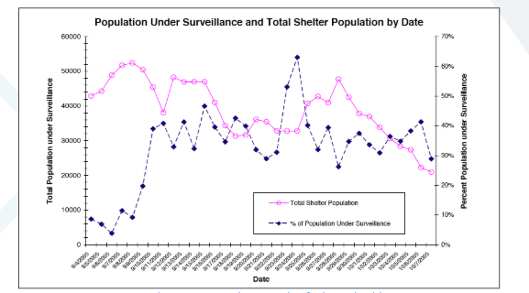
Check Your Understanding
Resources
Viz. notes:
Frame : 17
Slide 1 of 1
Layout Name:
External image:
Treatment:
Please recreate the image from the source ppt.
Display the chart in sync with AX1 and Ax2.
Teambuilding I Check Your Understanding
Setting Up and Strengthening Disease Surveillance Systems During Emergencies I Daily Report
Note to the Client:
Please share more insights on this graph.
Notes:
[Ax1 After seeing a sample of the monthly report, let us see a daily report.
[Ax2] The report shows the Post-Katrina Surveillance at Louisiana.

Slide 23
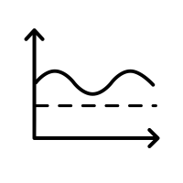




Check Your Understanding
Resources
Viz. notes:
Frame : 18
Slide 1 of 1
Layout Name:
External image:
https://static.thenounproject.com/png/2892276-200.png
https://static.thenounproject.com/png/3048657-200.png
https://static.thenounproject.com/png/2909312-200.png
https://static.thenounproject.com/png/1236833-200.png
https://static.thenounproject.com/png/3317810-200.png
Treatment:
This is a button screen. Make the text boxes look like buttons. The user can click in clockwise order. When the audio closes highlight the first button. Make the other buttons disabled. Display the icons and buttons on screen with text in sync with Ax1. The instruction text will be synced with IAX. Every time the user clicks, it will land on corresponding slides 23-28. When the user clicks the close button there. They come back to this screen. When all the buttons are seen. Then enable the next button from this screen.
Teambuilding I Check Your Understanding
Setting Up and Strengthening Disease Surveillance Systems During Emergencies I Constructing Surveillance
Baseline Data
Information Sources
Establish the Network
Mode of Reporting
Set Indicators
Click each button to know more.
Notes:
[Ax1] Constructing surveillance is a challenging task. While constructing surveillance, there are a few things that need to be kept in mind.
[IAX] Click each button to know more.

Slide 24
Check Your Understanding
Resources
Viz. notes:
Frame : 18
Slide 2 of 6
Layout Name:
External image:
Treatment:
Display the popup as soon as the user clicks the baseline data button.
Display the icon on the left and smart art tabs in sync with AX2. Sync the smart art OST with the corresponding audio part. Sync the IAX2 with the instruction text om screen. Once the audio finishes. Highlight the close button and take the user back to the main screen or slide 23.
Setting Up and Strengthening Disease Surveillance Systems During Emergencies I Constructing Surveillance
Teambuilding I Check Your Understanding
Acquire clear statistics of the population.
Know about endemic diseases and its disease profile.
Know potential vectors for air, water, and vector-borne diseases.
Check the current capacity of the current health care systems and health programs.
Baseline data
Information sources
Establish the Network
Baseline Data
Mode of Reporting
Set Indicators

Slide 25
Check Your Understanding
Resources
Viz. notes:
Frame : 18
Slide 3 of 6
Layout Name:
External image:
Treatment:
Display the popup as soon as the user clicks the Information sources button.
Display the icon on the left and smart art tabs in sync with AX3. Sync the smart art OST with the corresponding audio part.
Once the audio finishes. Highlight the close button and take the user back to the main screen or slide 23.
Setting Up and Strengthening Disease Surveillance Systems During Emergencies I Constructing Surveillance
Teambuilding I Check Your Understanding
Census
MoH reports
WHO archives
Peer-reviewed literature
Gray literature
Situation reports
Baseline data
Information sources
Establish the Network
Information Sources
ProMED
Mode of Reporting
Set Indicators

Slide 26
Check Your Understanding
Resources
Viz. notes:
Frame : 18
Slide 4 of 6
Layout Name:
External image:
Treatment:
Display the popup as soon as the user clicks the button.
Display the icon on the left and smart art tabs in sync with AX4. Sync the smart art OST with the corresponding audio part.
Once the audio finishes. Highlight the close button and take the user back to the main screen or slide 23.
Setting Up and Strengthening Disease Surveillance Systems During Emergencies I Constructing Surveillance
Teambuilding I Check Your Understanding
Local community
NGOs
Households
Baseline data
Information sources
Establish the Network
MoH health facilities
Community leaders
Establish the Network
Mode of Reporting
Set Indicators

Slide 27
Check Your Understanding
Resources
Viz. notes:
Frame : 18
Slide 5 of 6
Layout Name:
External image:
Treatment:
Display the popup as soon as the user clicks the button.
Display the icon on the left and the Table in sync with AX5. Sync the OST in the table with the corresponding audio part.
Once the audio finishes. Highlight the close button and take the user back to the main screen or slide 23.
Setting Up and Strengthening Disease Surveillance Systems During Emergencies I Constructing Surveillance
Teambuilding I Check Your Understanding
Active Reporting | Passive Reporting
Workers approach people to get the information. | Information is obtained when people visit the health facilities.
Baseline data
Information sources
Establish the Network
Mode of Reporting
Mode of Reporting
Set Indicators

Slide 28
Check Your Understanding
Resources
Viz. notes:
Frame : 18
Slide 6 of 6
Layout Name:
External image:
Treatment:
Display the popup as soon as the user clicks the button.
Display the icon and the OST setting the indicators in sync with AX6.
Display the boxes on the right one by one in sync with the given audio AX7 to Ax9 in the given sequence.
Once the audio finishes. Highlight the close button and take the user back to the main screen or slide 23.
Setting Up and Strengthening Disease Surveillance Systems During Emergencies I Constructing Surveillance
Teambuilding I Check Your Understanding
A list of diseases should be readily available for reference.
Baseline data
Information sources
Establish the Network
Case definitions require a balance between being insufficiently specific or false cases and insufficiently sensitive or missed cases.
Set Indicators
Health services delivery list of indicators must include information about access, personnel, facilities, and laboratory capacity.
Mode of Reporting
Set Indicators

Slide 29
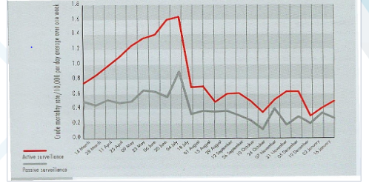
Check Your Understanding
Resources
Viz. notes:
Frame : 19
Slide 1 of 1
Layout Name:
External image:
Treatment:
Please recreate the image from the SB.
Display the chart in sync with AX1 and Ax1.
Highlight the red line and the grey line with Ax2 and Ax3.
Teambuilding I Check Your Understanding
Setting Up and Strengthening Disease Surveillance Systems During Emergencies I Daily Report
Note to the Client:
Please share more insights on this graph.
Active vs. Passive Surveillance at Burmese Refugee Camps
Notes:
[Ax1] Here is an example of a report that shows Active vs. Passive Surveillance at Burmese Refugee Camps.
[Ax2] The graph displays that active surveillance can catch more cases compared to passive surveillance.
[Ax3] However, it has less sensitivity, which means that it catches false cases as well.

Slide 30

Check Your Understanding
Resources
Viz. notes:
Frame : 20
Slide 1 of 2
Layout Name:
External image:
Treatment:
Sync the Ax1 with the OST.
Then display each audio starting from Ax2 insync with the image and the Smart art text.
Teambuilding I Check Your Understanding
Setting Up and Strengthening Disease Surveillance Systems During Emergencies I What is the future of surveillance?
Surveillance: The Future
Notes:
[Ax1] After discussing about the challenges, let us know what surveillance has in store for us in the future?

Slide 31




Check Your Understanding
Resources
Viz. notes:
Frame : 20
Slide 2 of 2
Layout Name:
External image:
https://t4.ftcdn.net/jpg/02/32/43/83/240_F_232438359_GvEtE8DpCqYz66I0d551P0o8EkjNZZog.jpg
https://t4.ftcdn.net/jpg/02/39/44/31/240_F_239443198_lNZoCnODMNiSMVHilmvz9o6Y5heF845j.jpg
https://t4.ftcdn.net/jpg/02/49/36/73/240_F_249367346_ck438nFVsoVmtJyY2EhhPeNUCUf8W7Hz.jpg
Treatment:
Display the OST in the blue box in sync with the first sentence of Ax2. then show each image and labels with the audio. The images will appear in a clockwise manner.
Teambuilding I Check Your Understanding
Setting Up and Strengthening Disease Surveillance Systems During Emergencies I What is the future of surveillance?
Surveillance can be improved by:
Employing common capacity technologies
Creating portals of entry for field data
Building local community partnerships
Sharing the global data networks
Notes:
[Ax2] Surveillance can be improved by:
Employing common capacity technologies such as cell phone, short messaging service capacity or SMS, and geo-referencing data points;
Creating portals of entry for field data;
Building local community partnerships; and
Sharing the global data networks.

Slide 32

Check Your Understanding
Resources
Viz. notes:
Frame : 21
CYU Multiple Choice Single Select
Slide 1 of 3
Layout Name: MCQ
External image:
https://t4.ftcdn.net/jpg/02/11/56/55/240_F_211565550_CkDYx0cu7opYE3C2jlKxIFKAAxNHZklc.jpg
Treatment:
The screen will load with the image, question and options.
FOLLOW STANDARD LAYOUT FOR CYUs.
Correct answer:
Explain the root causes for an event
Setting Up and Strengthening Disease Surveillance Systems During Emergencies I Check Your Understanding
Teambuilding I Check Your Understanding
Which of the following things the surveillance does not do?
Analyze the health event data regularly
Inform about the program and resource use
Explain the root causes for an event
Generate a response when an event threshold is crossed
Submit
Select the correct option, and click Submit.
Notes:
[AX1]
Congratulations on making it this far! Here’s a question to check your understanding.

Slide 33

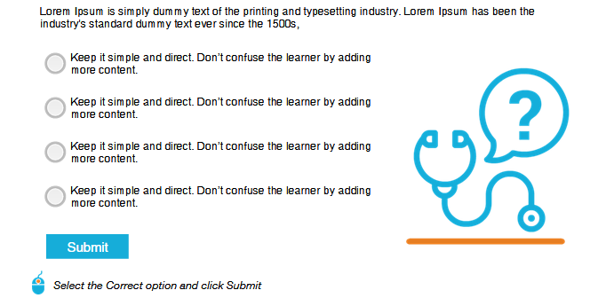
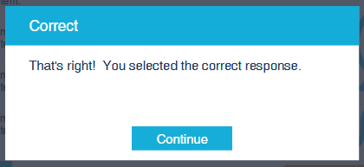
Check Your Understanding
Resources
Viz. notes:
Frame : 21
CYU Multiple Choice Single Select
Slide 2 of 3
Treatment: The pop up appears on correct selection
Setting Up and Strengthening Disease Surveillance Systems During Emergencies I Check Your Understanding
Teambuilding I Check Your Understanding
Increased participation is an opportunity, but what might its challenge be?
Tomato Spotted Wilt Virus is caused by which of the following vectors?
Select the option that you think is correct, and click Submit.
Ineffective decision making
Yes, and. . . is a process that requires you to listen and acknowledge the richness of someone else’s contribution.
Poor implementation and follow-through
Surveillance does not explain the root causes for an event.
aphids
whiteflies
thrips
mites
Lack of empowerment and organizational support
Lack of clarity
Submit

Slide 34
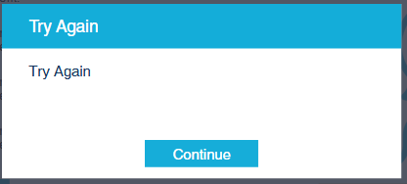
Check Your Understanding
Resources
Viz. notes:
Frame : 21
CYU Multiple Choice Single Select
Slide 3 of 3
Treatment: The pop up appears on incorrect selection
Setting Up and Strengthening Disease Surveillance Systems During Emergencies I Check Your Understanding
Increased participation is an opportunity, but what might its challenge be?
Tomato Spotted Wilt Virus is caused by which of the following vectors?
Select the option that you think is correct, and click Submit.
Incorrect
Ineffective decision making
Yes, and. . . is a process that requires you to listen and acknowledge the richness of someone else’s contribution.
Incorrect
Poor implementation and follow-through
aphids
whiteflies
thrips
mites
Surveillance does not explain the root causes for an event.
Lack of empowerment and organizational support
Lack of clarity
Submit

Slide 35

Check Your Understanding
Resources
Viz. notes:
Frame : 22
CYU Multiple Choice Single Select
Slide 1 of 3
Layout Name: MCQ
External image:
https://t3.ftcdn.net/jpg/02/55/17/90/240_F_255179011_2KS999pd1aCb6YA9tZh90i59CPWmMhPF.jpg
Treatment:
The screen will load with the image, question and options.
FOLLOW STANDARD LAYOUT FOR CYUs.
Correct answer:
Population structure
Setting Up and Strengthening Disease Surveillance Systems During Emergencies I Check Your Understanding
Teambuilding I Check Your Understanding
Which of the following is not measured by surveillance?
Communicable disease morbidity
Noncommunicable diseases morbidity
Resources available for curative and preventive care services
Population structure
Submit
Select the correct option, and click Submit.
Notes:
[AX1]
Here’s another question for you.

Slide 36
Check Your Understanding
Resources
Viz. notes:
Frame : 22
CYU Multiple Choice Single Select
Slide 2 of 3
Treatment: The pop up appears on correct selection
Setting Up and Strengthening Disease Surveillance Systems During Emergencies I Check Your Understanding
Teambuilding I Check Your Understanding
Increased participation is an opportunity, but what might its challenge be?
Tomato Spotted Wilt Virus is caused by which of the following vectors?
Select the option that you think is correct, and click Submit.
Ineffective decision making
Yes, and. . . is a process that requires you to listen and acknowledge the richness of someone else’s contribution.
Poor implementation and follow-through
Population structure is not measured by surveillance.
aphids
whiteflies
thrips
mites
Lack of empowerment and organizational support
Lack of clarity
Submit

Slide 37
Check Your Understanding
Resources
Viz. notes:
Frame : 22
CYU Multiple Choice Single Select
Slide 3 of 3
Treatment: The pop up appears on incorrect selection
Setting Up and Strengthening Disease Surveillance Systems During Emergencies I Check Your Understanding
Increased participation is an opportunity, but what might its challenge be?
Tomato Spotted Wilt Virus is caused by which of the following vectors?
Select the option that you think is correct, and click Submit.
Incorrect
Ineffective decision making
Yes, and. . . is a process that requires you to listen and acknowledge the richness of someone else’s contribution.
Incorrect
Poor implementation and follow-through
aphids
whiteflies
thrips
mites
Population structure is not measured by surveillance.
Lack of empowerment and organizational support
Lack of clarity
Submit

Slide 38

Check Your Understanding
Resources
Viz. notes:
Frame : 23
CYU Multiple Choice Single Select
Slide 1 of 3
Layout Name: MMCQ
External image:
https://t4.ftcdn.net/jpg/02/94/30/39/240_F_294303990_sr1Dpqu88B701rhUOloAcD7RVTm83Sbl.jpg
Treatment:
The screen will load with the image, question and options.
FOLLOW STANDARD LAYOUT FOR CYUs.
Correct answer:
Insufficiently specific
Insufficiently sensitive
Setting Up and Strengthening Disease Surveillance Systems During Emergencies I Check Your Understanding
Teambuilding I Check Your Understanding
Case definitions require balance between being __________ and _____________ cases.
Fill in the blanks with the correct options.
Insufficiently specific
Insufficiently sensitive
MoH reports
ProMED
Submit
Select the correct options, and click Submit.
Notes:
[AX1]
Here is one more question to check your understanding.

Slide 39
Check Your Understanding
Resources
Viz. notes:
Frame : 23
CYU Multiple Choice Single Select
Slide 2 of 3
Treatment: The pop up appears on correct selection
Setting Up and Strengthening Disease Surveillance Systems During Emergencies I Check Your Understanding
Teambuilding I Check Your Understanding
Increased participation is an opportunity, but what might its challenge be?
Tomato Spotted Wilt Virus is caused by which of the following vectors?
Select the option that you think is correct, and click Submit.
Ineffective decision making
Yes, and. . . is a process that requires you to listen and acknowledge the richness of someone else’s contribution.
Poor implementation and follow-through
Case definitions require balance between being insufficiently specific and insufficiently sensitive cases.
aphids
whiteflies
thrips
mites
Lack of empowerment and organizational support
Lack of clarity
Submit

Slide 40
Check Your Understanding
Resources
Viz. notes:
Frame : 23
CYU Multiple Choice Single Select
Slide 3 of 3
Treatment: The pop up appears on incorrect selection
Setting Up and Strengthening Disease Surveillance Systems During Emergencies I Check Your Understanding
Increased participation is an opportunity, but what might its challenge be?
Tomato Spotted Wilt Virus is caused by which of the following vectors?
Select the option that you think is correct, and click Submit.
Incorrect
Ineffective decision making
Yes, and. . . is a process that requires you to listen and acknowledge the richness of someone else’s contribution.
Incorrect
Poor implementation and follow-through
aphids
whiteflies
thrips
mites
Case definitions require balance between being insufficiently specific and insufficiently sensitive.
Lack of empowerment and organizational support
Lack of clarity
Submit

Slide 41

Summary
Viz. notes:
Frame: 24
Summary
Slide 1 of 1
External Images:
https://t3.ftcdn.net/jpg/03/04/60/34/240_F_304603468_qruj3lbg30Xiq2eHVBW9UvMHIoMWA0Gq.jpg
Treatment:
Display the TOS and image one by one in sync with the audio.
Let us summarize all that you have learned.
The ongoing systematic collection, analysis, and interpretation of data along with the dissemination of information to plan implement and evaluate public health interventions is known as Surveillance.
The limitations of surveillance are listed below:
Surveillance cannot capture every morbidity event.
Not all cases have access.
Surveillance cannot provide true incidence or prevalence of event in the community.
Surveillance cannot explain root causes for an event.
Surveillance cannot explain the reasons for improvement and replacing M&E.
Characteristics of effective surveillance include:
Establishing other public health activities at the same time in the phase of emergency response
Engaging with a wide range of stakeholders
Being simple and clear for workers as well as utilizers
Defining thresholds for the target diseases
Functioning in the recovery phase of a disaster
Integrating surveillance in the routine health information system
CD surveillance used during emergencies should be designed to answer the following questions:
What do you want to know?
How often do you want to know?
Whom do you want to know about?
Where it should be done?
How should it be done?
Surveillance requires time, place, and person.
While constructing surveillance, it is important to keep a tab on the baseline data available on population, endemic diseases, potential vectors for air, water, and vector-borne diseases. Lastly, it’s important to assess the current capacity of the current healthcare systems and health programs.
Notes:
[AX1] That brings us to the end of the Setting Up and Strengthening Disease Surveillance Systems During Emergencies session. Let us summarize all that you have learned.
[Ax2] The ongoing systematic collection, analysis, and interpretation of data along with the dissemination of information to plan implement and evaluate public health interventions is known as Surveillance.
The limitations of surveillance are listed below:
Surveillance cannot capture every morbidity event.
Not all cases have access.
Surveillance cannot provide true incidence or prevalence of event in the community.
Surveillance cannot explain root causes for an event.
Surveillance cannot explain the reasons for improvement and replacing M&E.
Characteristics of effective surveillance include:
Establishing other public health activities at the same time in the phase of emergency response
Engaging with a wide range of stakeholders
Being simple and clear for workers as well as utilizers
Defining thresholds for the target diseases
Functioning in the recovery phase of a disaster
Integrating surveillance in the routine health information system
CD surveillance used during emergencies should be designed to answer the following questions:
What do you want to know?
How often do you want to know?
Whom do you want to know about?
Where it should be done?
How should it be done?
Surveillance requires time, place, and person.
While constructing surveillance, it is important to keep a tab on the baseline data available on population, endemic diseases, potential vectors for air, water, and vector-borne diseases. Lastly, it’s important to assess the current capacity of the current healthcare systems and health programs.

Slide 42

Course Completion.
Resources
Viz. notes:
Frame: 25
Session completion
Slide 1 of 1
External Sources:
https://t3.ftcdn.net/jpg/01/96/63/64/240_F_196636468_bihE0du2Nn44sgO39b8aqkZmug15bNH2.jpg
Layout Name: Course Completion
Treatment:
The screen will load with the image and ‘congratulations!’ text.
The rest of the text will display immediately after that.
The buttons will be highlighted in synch with IAX.
Session Completion
Congratulations, you have successfully completed the Setting Up and Strengthening Disease Surveillance Systems During Emergencies session.
This session was adapted Gregg Greenough. Public Health Surveillance in Complex Emergencies, Harvard Humanitarian Initiative.
Exit Session
Restart Session
Notes:
[AX1]
Congratulations, you have successfully completed the Setting Up and Strengthening Disease Surveillance Systems During Emergencies session.
[IAX]
Click the Exit Session button to close the window or the Restart Session button to take the session again.

